Slide 1
Weaving crosscutting concerns into inter-process communications(IPC) in AspectJ
ICSEA 2013 Presentation
Ali Raza
Dr. Stephen W. Clyde
Utah State University
Notes:
Here are few tips about preparing and giving a presentation:
- Know your audience. This conference is not your research committee, but software people in general with a wide range of backgrounds
- Make sure the motivation is crystal clear
- Use simple, visual slide if possible -- "Show them" instead of just "Telling Them"
- Don't cut-n-paste bitmap images. They so scale and alway end up being hard to read. There's still one in this slide set.
- Keep examples focus exactly on the point you trying to make -- all that's necessary, with nothing that could be considered extraneous.

Slide 2
A Fundamental Software Engineering Principle
Good Modularity
Maintainability
Flexibility
Reuse
Extensibility

Slide 3
A Couple of Domain Terms
Inter-Process Communications (IPC)
Any kind of message passing between processes
IPC Software Development Kit (SDK)
A library or framework implementing IPC, e.g. socket or channels
IPC Operation
SDK-level method or function calls, e.g., send or receive
Conversation
A sequences of messages exchanged between two more processed for some specific purpose
Protocol
A definition for valid conversations, including message syntax, ordering, timing, and semantics

Slide 4
Introduction
Inter-Process Communications (IPC) in distributed software systems can be or become poorly modularized, because
A single system may support multiple protocols and maybe multiple versions of each
A single system may use different kinds of IPC SDK’s (e.g., sockets, channels, etc.)
IPC Operations may be scattered through the code
From a process’s perspective, the sends and receives for a conversation are usually not contiguous in the process’s execution flow. In fact, they are typically handled on separate execution threads
Supporting or secondary logic, such as logging or message translation, can become tangled into core application code

Slide 5
Distributed System Example
A
B
Consider:
Two processes, A and B
A simple request-reply communication protocol
Multiple concurrent conversations possible

Slide 6
Distributed System Example
Consider:
Another process, C, that also communicates with B
Using a more complicated, multi-step protocol
Again, multiple concurrent conversations possible
C
B

Slide 7
Distributed System Example
C
D
Consider:
Another process, D, that communicates with C
Using a variety of different communication protocols
Again, multiple concurrent conversations possible

Slide 8
Distributed System Example
B
E
D
D’
Consider:
A process, E, that communicates with both B and D in following a multi-step, multi-process protocol
Also assume there is another older version of D, i.e. D’, that needs to remain operational
Again, multiple concurrent conversations possible

Slide 9
Distributed System Example
A
C
B
E
D
Secondary requirements may be added at any time during the development and evolution of a system

Slide 10
Distributed System Example
A
C
Measure performance and throughput of round-trip request-reply conversations
B
E
D
Secondary requirements may be added at any time during the development and evolution of a system

Slide 11
Distributed System Example
A
C
Log all communications, when in “monitoring” mode
B
E
D
Secondary requirements may be added at any time during the development and evolution of a system

Slide 12
Distributed System Example
A
C
Support multiple versions of a protocol for legacy systems
B
E
D
Secondary requirements may be added at any time during the development and evolution of a system

Slide 13
The Problem
A
C
B
E
D
Communication-related requirements can impact multiple processes and protocols
The core communication logic may be scattered throughout the overall software
Secondary requirements may cause get tangling of supporting logic into core communication logic

Slide 14
Where Next?
An Overview of Aspect Orientation & AspectJ
Communication Aspects – CommJ
An overview of the approach
Universe Model for Communication
Message Event Join points
Event Trackers
Base Aspects
Reusable Aspect Library
Application-level Communication Aspects
Discussion

Slide 15
Aspect Orientation
Stems from object-oriented software development, where
Some “concerns”, e.g. requirements, seem to cut through lots of object definitions (i.e., classes)
These crosscutting concerns (CC’s) may be added or dropped from a system at anytime during it’s life cycle and, therefore, need to independent of core application logic
These CC’s are, themselves, reusable ideas that may apply to many applications or domains

Slide 16
Aspect Orientation
Scattering occurs when the logic for a CC is found in multiple places throughout the code.
Tangling occurs when the logic for a CC is becomes intertwined with core application logic
AO seeks to localize the logic for CC’s and de-tangle it from core application logic, such that core logic is oblivious to whether any particular CC’s is currently in effect.

Slide 17
AspectJ
AspectJ is an AO Programming Language, based on Java
With AspectJ, developers encapsulate CC’s in Aspects:
First-class abstract data types, like classes
Include
Advice, which implement CC logic
Pointcuts, which define join points, which turn define possible places where the advice may be needed

Slide 18
AspectJ
In AspectJ, the join points relate to basic control structures and operations: e.g. calling methods, execution of constructors, throw of exceptions, setting an attribute value, etc.
When advice applies to an instance of a join point, then the control structure or operation, and the object involved are the context of the advice.
AspectJ has no mechanism for defining contexts for conversations or even individual messages

Slide 19
CommJ and Communications Aspects
Application-level Aspects
Reusable Aspect Library
Core CommJ Infrastructure
Universal Model of Communications

Slide 20
CommJ and Communications Aspects
Provides a theoretical foundation for providing communication joint points and contexts:
Joint points correspond to events, e.g. message send and receive
Messages have identify and can be part of a conversation
Conversations follow protocols
And more
Application-level Aspects
Reusable Aspect Library
Core CommJ Infrastructure
Universal Model of Communications

Slide 21
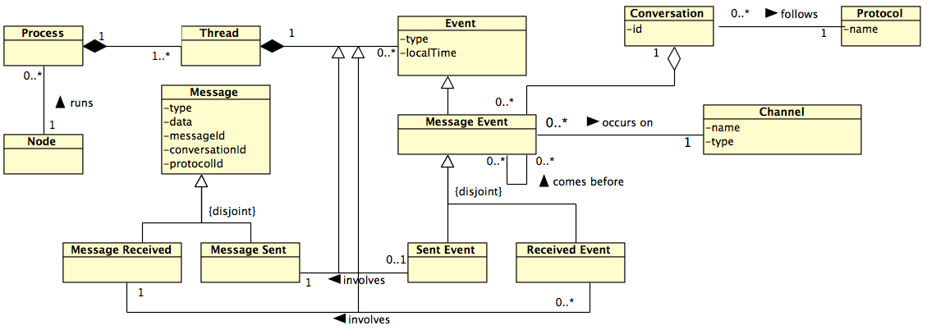
Universal Model of Communications
UML representation for part of the Universal Model of Communications (UMC)

Slide 22
CommJ and Communications Aspects
Implements classes for
representing communication contexts
trackers and monitor for managing these contexts
handling application-specification message identifying information
Defining common and application-specific protocols
Application-level Aspects
Reusable Aspect Library
Implements base aspects for weaving comm. advice
Core CommJ Infrastructure
Universe Model of Communications

Slide 23
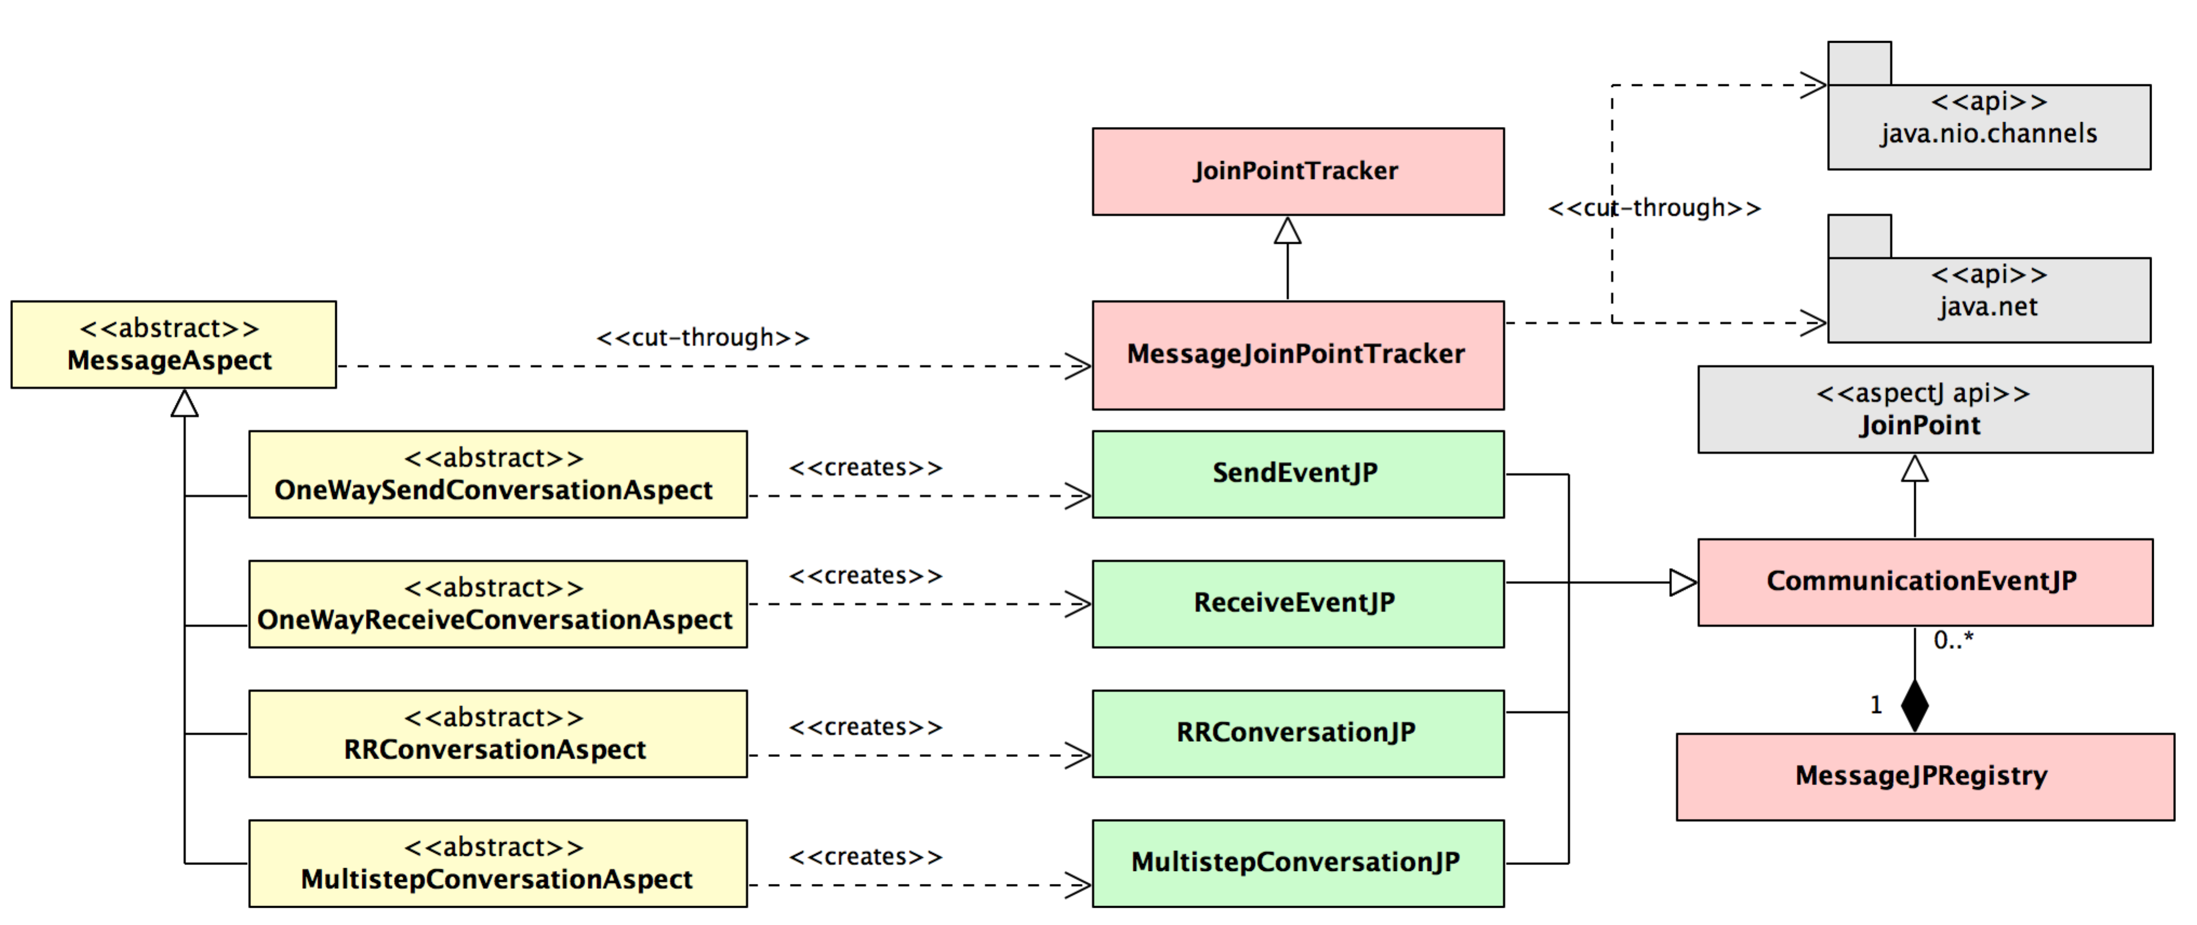
Core CommJ Infrastructure
UML representation of CommJ’s core infrastructure

Slide 24
Core CommJ Infrastructure
Implemented as Aspects
UML representation of CommJ’s core infrastructure

Slide 25
Core CommJ Infrastructure
Implemented as Classes
UML representation of CommJ’s core infrastructure

Slide 26
CommJ and Communications Aspects
Application-level Aspects
Reusable Aspect Library
Core CommJ Infrastructure
Implements a set of useful communications aspects, with applicability across a wide range of domains.
Universe Model of Communications

Slide 27
Reusable Aspect Library (RAL)
Uses or extents core infrastructure
Examples:
Debug logging
Conversation performance measures
System throughput performance measures
Application-level message encryption
Audit logging
Intended to be expanded over time

Slide 28
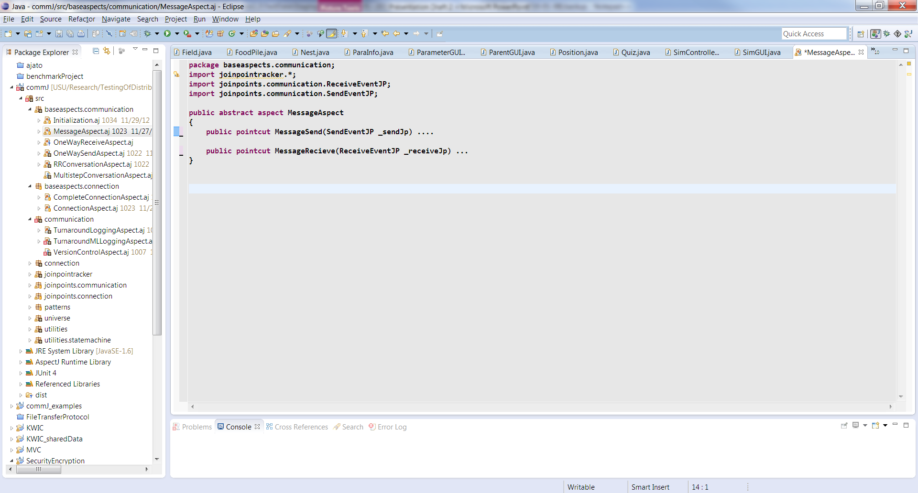
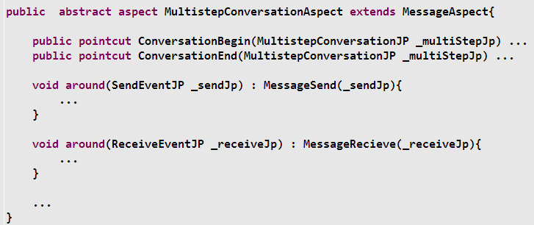
Code Snippets from CommJ

Slide 29
CommJ and Communications Aspects
Application-level Aspects
Reusable Aspect Library
Core CommJ Infrastructure
Aspects that implement custom communication CC’s – anything you can imagine!
Universe Model of Communications

Slide 30
Example of Turnaround-Time CC
Conversation: Alice requests some data from Sue and sends it to Bob, and receives an acknowledgement back
Sue
Msg #1
Msg #2
Alice
Msg #3
Bob
Msg #4

Slide 31
Computing Turn-around Time
Conversation’s context from Alice’s perspective:
Initial
Msg #1 sent
Waiting for response from Sue
T1
Msg #2 received
Got response from Sue
Turn-around Time = TS2 – TS1
Msg #3 sent
Acknowledgement Received
T2
Waiting for acknowledgement from Bob
Msg #4 received

Slide 32
Code from Turnaround-Time Aspect
public aspect TurnaroundTimeAspect extends MultistepConversationAspect
{
private long startTime = 0;
before(MultistepConversationJP _multiStepJP) :
ConversationBegin(_multiStepJP) // Pointcut from base aspect
{
startTime = System.currentTimeMillis();
}
after(MultistepConversationJP _multiStepJP):
ConversationEnd(_multiStepJP) // Pointcut from base aspect
{
String TimeInof = String.format(”Total Time for conversation is %.3g%n",
new Double(System.currentTimeMillis() - startTime)/1000);
log(timingInfo);
}
…
}

Slide 33
Discussion
CommJ can improved modularity, reuse and maintainability of communication crosscutting concerns by
Preventing scatting CC logic
Providing a way of detangling CC’s from core application logic
Localizing and encapsulating CC’s in reusable modules
UMC formalizes communication join points and contexts
CommJ’s Core Infrastructure make Communication Aspects seamless in AspectJ
The RAL provides a library of useful Communication Aspects

Slide 34
Thank you!

